Slide 1
Yes bank Stock Prediction
BY
Abhishek Kumar Mishra
Individual Project

Slide 2
Content
Objective
Problem Statement
Data Summary
Data Summary
EDA
Modelling
Conclusion

Slide 3
Objective
The main objective is to build a prediction model for the stock’s closing price of the month.

Slide 4
Problem Statement
Yes Bank is known bank in the Indian financial domain. Since 2018, because of the fraud case involving Rana Kapoor. Owing to this fact, it was interesting to see how that impacted the stock prices of the company.
This dataset has monthly stock prices of the bank since its inception and includes closing, starting, highest, and lowest stock prices of every month.

Slide 5
Data Summary
Date: It denotes date of investment done.
Open: Open means the price at which a stock started trading when the opening bell rang.
High: The maximum prices in a given time period.
Low: The minimum prices in a given time period.
Close: The price of an individual stock at the end of the considered time period

Slide 6
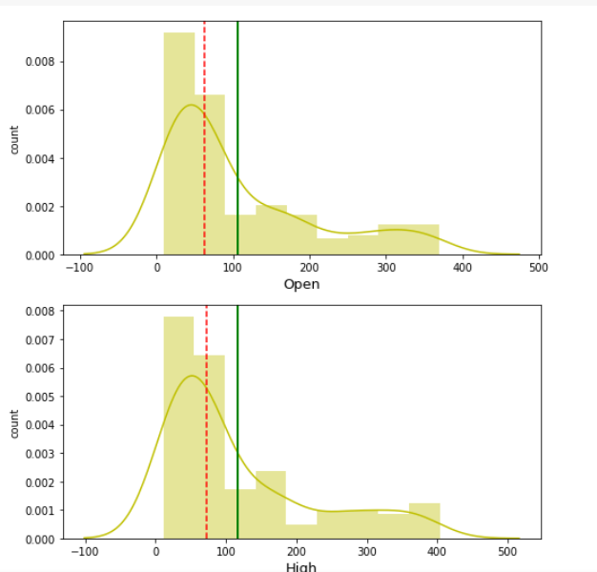
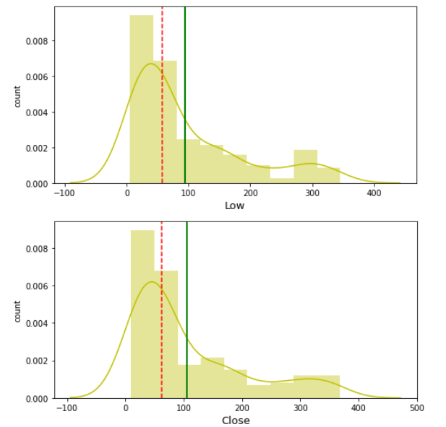
Exploratory Data Analysis:
Data Visualization:
Univariate Analysis:
Yes bank stock market dataset all the features have positively skewed distributions

Slide 7
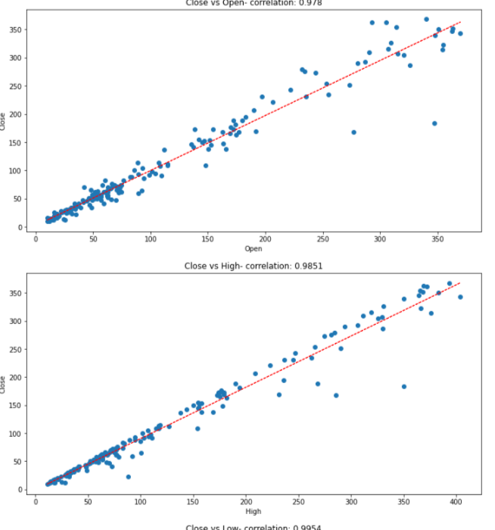
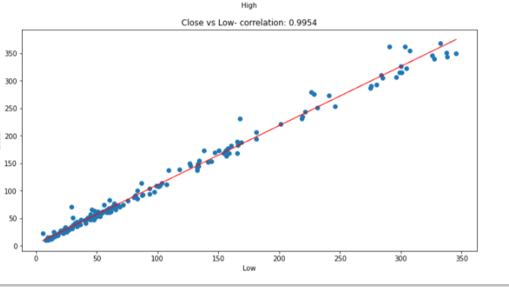
Exploratory Data Analysis:
Data Visualization:
Supervised learning, it determine the essential predictors when the bivariate analysis is done by plotting one variable against another
Bivariate Analysis:

Slide 8
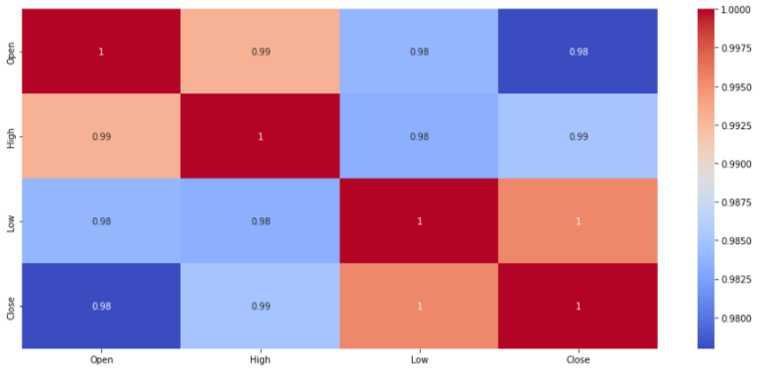
Correlation Analysis:
Agatha Christie wrote highest number of books.

Slide 9
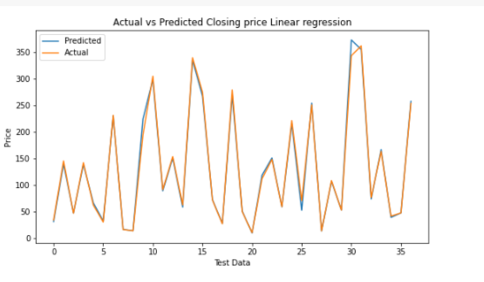
Modelling
Linear Regression
Linear regression is one of the easiest and most popular Machine Learning algorithms.
It works best when there is a linear relationship between dependent and independent variables.
Root Mean Square Error is approximately 8.3917.
Adjusted R Square is approximately 0.8212.
Harlequin published highest number of books.

Slide 10
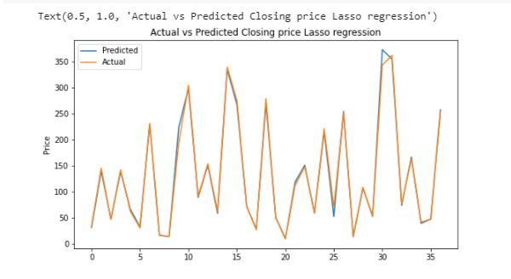
Modelling
Lasso Regression
(with cross-validation):
Lasso regression is to obtain the subset of predictors that minimizes prediction error for a quantitative response variable.
RMSE for lasso regression is 8.3864.
Adjusted R-squared value is 0.9932
Harlequin published highest number of books.

Slide 11
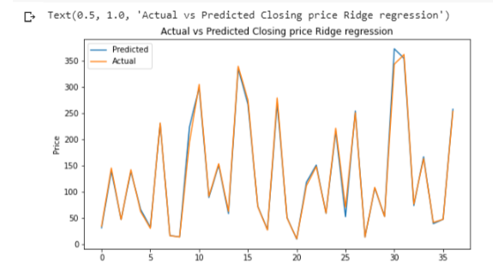
Modelling
Ridge Regression with cross-validation:
Ridge regression is a regularized linear regression similar to lasso.
RMSE for Ridge regression is 8.3824
Adjusted R-squared value for Ridge regression is 0.9932.
Harlequin published highest number of books.

Slide 12
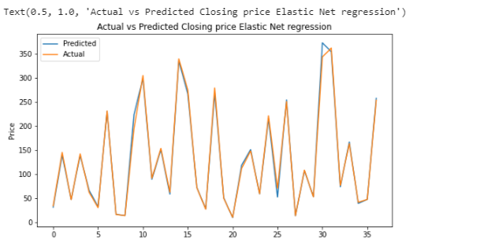
Modelling
Elastic Net Regression with cross-validation:
Elastic net regression works in a manner that takes the best of lasso and ridge regressions.
RMSE for Elastic Net regression is 8.3760.
Adjusted R-squared value for Elastic Net regression is 0.9932
Harlequin published highest number of books.

Slide 13
Conclusions
By data visualization on our target variable, clearly see the impact of 2018 fraud case involving Rana Kapoor as the stock prices decline dramatically during that period.
After loading the dataset, found that there are no null values in our dataset.
The distribution of all our variables is positively skewed, so performed log transformation on them.
There is a high correlation between the dependent and independent variables.
This is a signal that our dependent variable is highly dependent on our features and can be predicted accurately from them.

Slide 14
Conclusions
There is a rather high correlation between our independent variables.
This multicollinearity is however unavoidable here as the dataset is very small.
Implemented several models on our dataset in order to be able to predict the closing price and found that all our models are performing remarkably well and Elastic Net regressor is the best performing model with Adjusted R2 score value of 0.9932 and scores well on all evaluation metrics.
All of the implemented models performed quite well on our data giving us the Adjusted R-square of over 99%.

